Slide 1

A
Guide To Calculus

Slide 2
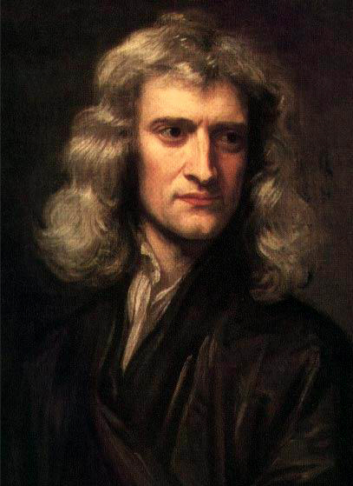
Baseline Rendering

Slide 3


Baseline vs. Progressive Rendering
25%
50%
100%

Slide 4
Circle and Sphere Fun Facts

Slide 5
Dissecting a Circle
~
Disc
Rings

Slide 6
Unroll the Rings
Area =
½ base x height

Slide 7
X-Ray
Original
Rings
Slices
Boards

Slide 8
Ring By Ring
25%
50%
75%
100%

Slide 9
Slice By Slice

Slide 10
Board By Board

Slide 14
Strategy | Visualization | Step-by-Step Layout | Single Step Zoom
Ring-by-ring
Slice-by-slice
Board-by-board
r
dr
p
dp
x
dx

Slide 15
Strategy | Visualization | Step-by-Step Layout | Calculus Lingo
Ring-by-ring
Slice-by-slice
Board-by-board

Slide 16
Circle
Rings
Slices
Boards
Sphere
Shells
Wedges
Plates

Slide 17


Circumference
Area
Volume
Surface area
Ring-by-ring
Timelapse
Plate-by-plate
Timelapse
Shell-by-Shell
X-Ray

Slide 20
Derivative Symbol |  |  | Mindset
 |  |  | Think about the resulting step-by-step pattern
 |  |  | Think about the actual ratio of changes

Slide 21
1d Perimeter Change
2d Area Change
x
1
x

Slide 22

Infinity
…
Image source: wikipedia

Slide 23
The Derivative
1. Choose an interval
2. Find the raw change
4. Make your model perfect
3. Find the rate of change

Slide 24
=
1
+ 3
+ 5
+ 7
+ 9
5x5

Slide 25
=
5
+ 7
+ 9
5x5
-
2x2

Slide 26
George
Frank

Slide 27
dg
f × dg
df × dg
g
g × df
f
df

Slide 28
Slicing A Cake Among Friends
Cake
A
B
A
B
C
New person?
Cut a slice from everyone
A
B
C
D

Slide 29
Scenario With 2 Parts
Two Perspectives To Consider
F
+
G
F
*
G
Simplifies to
F’s changes
G’s changes
+
F
^
G
F
/
G
…

Slide 30
Scenario With 3 Parts
3 Perspectives To Consider
A’s changes
B’s changes
C’s changes
A
×
B
×
C
+
+

Slide 31
x²
x²
x²

Slide 32





Interaction | Overall Change
Addition
Multiplication
Powers
Inverse
Division

Slide 33
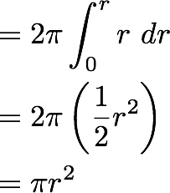



Strategy | Visualization | Step-by-Step Layout | Single Step Zoom
Ring-by-ring Timelapse
2πr
r
dr
Symbolic Description | Solution | Notes
Work backwards to the integral.
If
that means

Slide 34
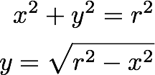
Strategy | Visualization | Height of Plate | Single Step Zoom
Plate-by-plate Timelapse
r
π y²
y
x
dx

Slide 35
=
+
=
2 ×

Slide 36

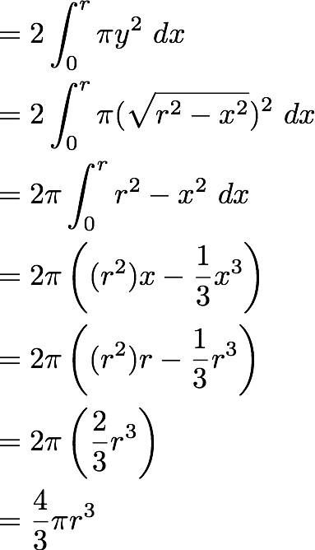
Symbolic | Solution | Notes
Write height in terms of x
Work backwards to find integrals
Find volume at full radius (x=r)

Slide 37

Strategy | Visualization | Shell Analysis
Shell-by-shell X-Ray
Strategy | Visualization | Shell Analysis
Shell-by-shell X-Ray
dV
dr

